Slide 1


Movie Recommendation System using Machine Learning
MACHINE LEARNING – COURSE BASED PROJECT
Course: Machine Learning | Course Code: E1UA406C
Presented by: Vansh Goel & Shiva Tyagi
Instructor: Dr. Sanjay T Singh
Course Name: Machine Learning
Course Code: E1UA406C
Course Instructor: Dr. Sanjay T Singh
Presented By:
Vansh Goel – 24SCSE1720002
Shiva Tyagi – 24SCSE

Slide 2
Table of Contents
Introduction
Understanding Machine Learning and recommendation systems
Problem Statement
Challenges in movie selection on streaming platforms
Project Objectives
Goals and learning outcomes of the project
Dataset Description
Data sources and key attributes used
Machine Learning Methodology
Step-by-step development process, ML Development Life Cycle
Core Techniques
How the recommendation engine works
Tools & Technologies
Python libraries and development environment
Expected Results & Future Scope
Output demonstration and potential improvements
2
Vansh Goel & Shiva Tyagi

Slide 3




Introduction to Machine Learning
Machine Learning is a transformative field of Artificial Intelligence that enables computers to learn patterns from data and make predictions without explicit programming. Rather than following rigid instructions, ML systems identify patterns and relationships in data, improving their performance through experience.
Real-World Applications
Machine Learning powers recommendation systems across major platforms, creating personalized experiences for millions of users daily:
Netflix
Amazon
Personalized movie and show recommendations based on viewing history and preferences
Product suggestions tailored to shopping behavior and browsing patterns
YouTube
Spotify
Video recommendations based on watch history, likes, and engagement metrics
Music discovery and playlist generation based on listening habits and preferences
This course focuses on developing algorithms that identify patterns and make predictions from data using Python, aligning with practical applications in industry and research.
3
Vansh Goel & Shiva Tyagi

Slide 4
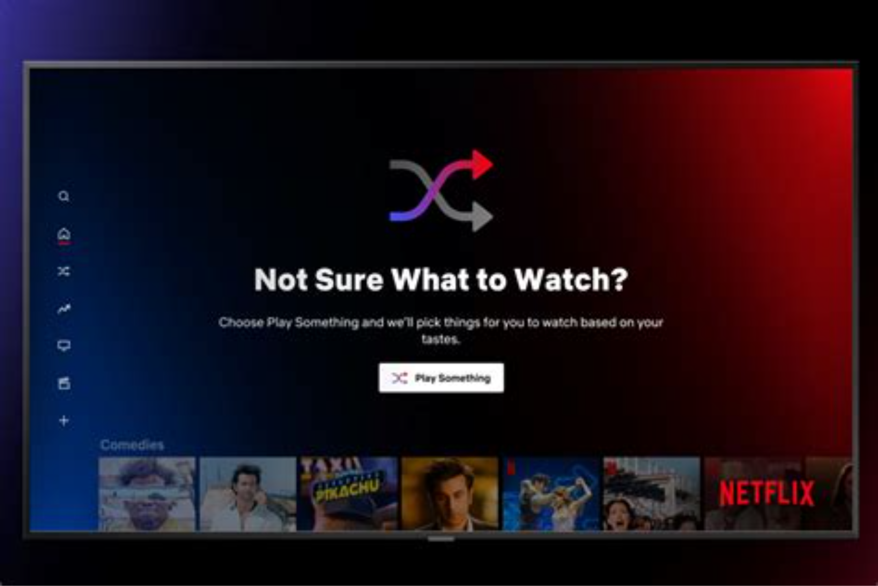
Problem Statement
The Challenge
With thousands of movies available on streaming platforms, users often find it difficult to choose what to watch. The overwhelming number of options can lead to decision paralysis and reduced user satisfaction.
The Solution
A Movie Recommendation System helps solve this problem by analyzing movie data and suggesting similar movies that match user preferences. The system processes vast amounts of information to surface relevant content quickly.
Technical Approach
The goal is to build a system that recommends movies based on similarity between movie features such as genre, keywords, and overview.
4
Vansh Goel & Shiva Tyagi

Slide 5

Project Objectives
The objectives of this project are designed to provide hands-on experience with real-world machine learning applications:
Understand Recommendation Systems
Apply ML Techniques
Gain foundational knowledge of how recommendation engines work, including different filtering approaches and their use cases in industry applications
Implement machine learning techniques for real-world problems, bridging theoretical concepts with practical implementation in Python
Preprocess Datasets
Build Similarity Engine
Learn data preprocessing techniques essential for model training, including data cleaning, feature engineering, and handling missing values
Develop a system that recommends movies based on similarity calculations using content-based filtering methods
This project directly aligns with the course objective of applying machine learning algorithms to solve real-world problems, providing practical skills for data science and AI careers.
5
Vansh Goel & Shiva Tyagi

Slide 6






Dataset Description
The project will utilize a comprehensive Movie Dataset such as the MovieLens or Kaggle Movie Dataset. These datasets contain thousands of movies with rich metadata that enables accurate similarity calculations.
Key Dataset Attributes
Movie Title
Genre
Official title of the movie for identification and display purposes
Category classifications such as action, comedy, drama, or thriller
Cast
Keywords
Lead actors and supporting performers in the movie
Descriptive terms capturing themes, settings, and concepts
Ratings
Overview
User ratings and review scores from audience members
Synopsis and plot description providing contextual information
These features will be used to determine similarity between movies, enabling the system to identify and recommend comparable titles based on shared characteristics.
6
Vansh Goel & Shiva Tyagi

Slide 7












Machine Learning Methodology
The project follows the Machine Learning Development Life Cycle, a systematic approach to building effective recommendation systems:
Data Collection
Data Preprocessing
Gather movie datasets from reliable sources like MovieLens or Kaggle, ensuring comprehensive coverage of titles and attributes
Clean and structure data by handling missing values, removing duplicates, and standardizing formats for consistency
Recommendation Generation
Feature Extraction
Generate and present top movie recommendations to users based on calculated similarity scores
Extract relevant features from text fields using techniques like TF-IDF vectorization to create numerical representations
Similarity Calculation
Model Development
Compute cosine similarity between movie vectors to identify closely related titles based on feature matching
Build the recommendation engine using content-based filtering algorithms and similarity calculation methods
7
Vansh Goel & Shiva Tyagi

Slide 8
Core Techniques
The system will use Content-Based Filtering with the following technical approaches:
TF-IDF Vectorization
Cosine Similarity
Convert text features (genres, keywords, overview) into numerical vectors that capture semantic meaning
Measure similarity between movie vectors using cosine angles, producing scores between 0 and 1
Tools & Technologies
The project leverages industry-standard Python libraries and development environments commonly used for data preprocessing and machine learning implementation:
Python
Pandas
Powerful data manipulation library for loading, cleaning, and transforming movie datasets efficiently
NumPy
Scikit-learn
Essential numerical computing library for array operations and mathematical calculations
Comprehensive machine learning framework providing TF-IDF vectorization and similarity calculation tools
8
Vansh Goel & Shiva Tyagi

Slide 9




Expected Output & Future Scope
Expected Output
The system will take a movie name as input and recommend 5 similar movies based on feature similarity calculations.
User Input
System Processing
Recommendations
Movie name entered by user
Similarity calculation and ranking
Top 5 similar movies displayed
Example
Input: Avengers
Output:
Iron Man
Captain America
Thor
Guardians of the Galaxy
Doctor Strange
9
Vansh Goel & Shiva Tyagi

Slide 10
Future Improvements
Potential enhancements to expand system capabilities:
1
Personalized Recommendations
2
Web Interface
3
Streaming Platform Integration
Develop an interactive web application with a user-friendly interface for seamless movie discovery
Incorporate user ratings and viewing history to provide tailored suggestions based on individual preferences
Connect with platforms like Netflix or Prime Video to provide real-time recommendations within existing services
10
Vansh Goel & Shiva Tyagi

